Slide 1
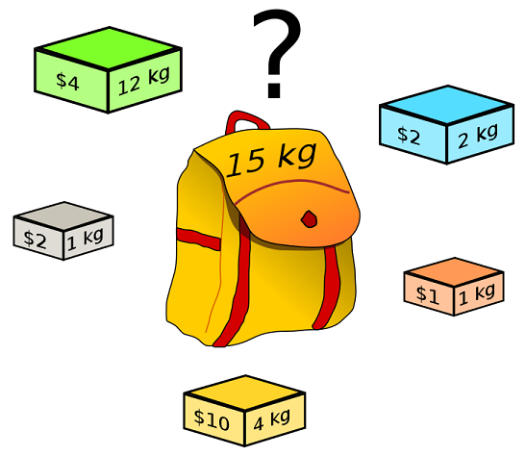
Max Knapsack NP-Complete Project Presentation
By Trevor Woodman, Joe Drake, Patrick Glebus, and Jacob Hataway

Slide 2
Bounded Max Knapsack
The Decision Problem:
Given a knapsack that can hold some maximum positive weight w, a target value v, and a list of items, each with a unique name, a weight, a value, and a maximum amount of copies of the item, does there exist a combination of items that achieves a value of at least v, while not exceeding weight w?
The Optimization Problem:
Given a knapsack and a set of items as described above, what combination of items achieves the maximum value possible, while not exceeding weight w?

Slide 3
Problem Input and Output
Input:
The input will begin with a single line containing a nonnegative integer weight w, representing the maximum capacity of the knapsack. This is followed by a single line that contains a nonnegative integer n followed by exactly n lines each of which contains four items (String, real, real, int). The first value is the item's name, the second is the dollar value of the item, the third is the item's weight, and the fourth is the availability bound on how many of that item you can put into the knapsack.
Output:
The output begins with a list of items in the knapsack, each with its name, value, and weight. The final line is the total value of items in the knapsack, formatted to two decimal places.
16 # Maximum weight of knapsack
3 # Amount of items
ring 100 5 2 # Name, value, weight, availability
gold 50 10 5
silver 50 5 1
ring 100 5 # Name, value, weight
silver 50 10
gold 50 1
200.00 # Total value of knapsack

Slide 4
Reduction (justify its inclusion in NP-Complete)
Show the reduction that justifies the problem is in NP-Complete

Slide 5
An explanation of pseudo-polynomial time
Why this problem looks polynomial but isn’t

Slide 6
Sketch of Exact Solution (pseudo-code)

Slide 7
Worst Case Example (if possible)

Slide 8
Test Cases
How did you generate them? (hopefully with a python program)
Test case Sizes?
Performance of test cases of different sizes?
Plot of the run time of your program as you increase the input size. You MUST run your program on inputs that cause your program to run more than 20 minutes.

Slide 9
Approximation Portion
By Trevor Woodman, Joe Drake, Patrick Glebus, and Jacob Hataway

Slide 10
Approximation
Sketch algorithm choices (anytime algorithms, greedy algorithms, stochastic algorithms).
Bounds on its performance
Plot comparing difference in run time and solution quality using your test cases.

Slide 11
Approximation Explanation
For solving the approximation, we use fractional knapsack to help us construct it
We assume for simplicity that all items individually fit in the sack. We first construct a list which we call S1. S1 will contain a list of {1,...,k} where k equals the last element that doesn’t exceed the total weight. Given this we continue to pack items greedily as long as possible until we exceed the total weight. Once no more items can be added into S1, we construct a second list S2 that adds the first element that did not fit into the first knapsack. Then S2 repeats what S1 did, greedily adding items until no more can fit into the bag.
Since S1 union S2 provides the upper bound for the Linear Programming Relaxation Problem, one of the sets (S1 or S2) must have at least (max_weight)/2. Therefore, we return whichever of S1 and S2 that contains better value to obtain a valid ½-approximation.

Slide 12
Non Optimal Input Example
In the example below, the input given does not give the optimal choice
300
3
ring 280 200 2
diamond 280 200 2
ruby 300 300 1
Optimal Output: [[ruby,300,300,1]]
300.00
Output Received: [[diamond, 280, 200, 2]]
280.00
Here we would have expected to get an output of one ruby but instead get a output of one diamond.
We get this output because the approximation will first get the first diamond for bag A because these items are sorted in a value/weight ratio, and then mark the second diamond as the first item that cannot fit in bag A. Then it can not add the ruby or any of the rings to bag A. In the creation of the second bag, the second diamond will be added before anything else, and therefore it is unable to add the ruby, thereby returning a non-optimal solution, but is within the ½ approximation bounds

Slide 13
Upper Bounds
The upper bound for this problem is fractional knapsack
The lower bound for this problem is our approximation of bounded knapsack.
The time complexity for the computation of our bounded knapsack algorithm is O(n^2), where n is the total number of items not just the unique items. To sort the array by value/weight ratio is O(nlogn).

